Slide 1

Noor Ahamed Vempalle Rachana Nagaraj Banakar Prajay Reddy Minuka Sasank Reddy Dodula
Introduction to Google BigQuery

Slide 2

What is Google BigQuery ?
A fully-managed, cloud-based, and serverless data warehouse and analytical database management system
Developed by Google Cloud
Designed for high-performance, data analysis and querying. It is scalable and cost-effective

Slide 3
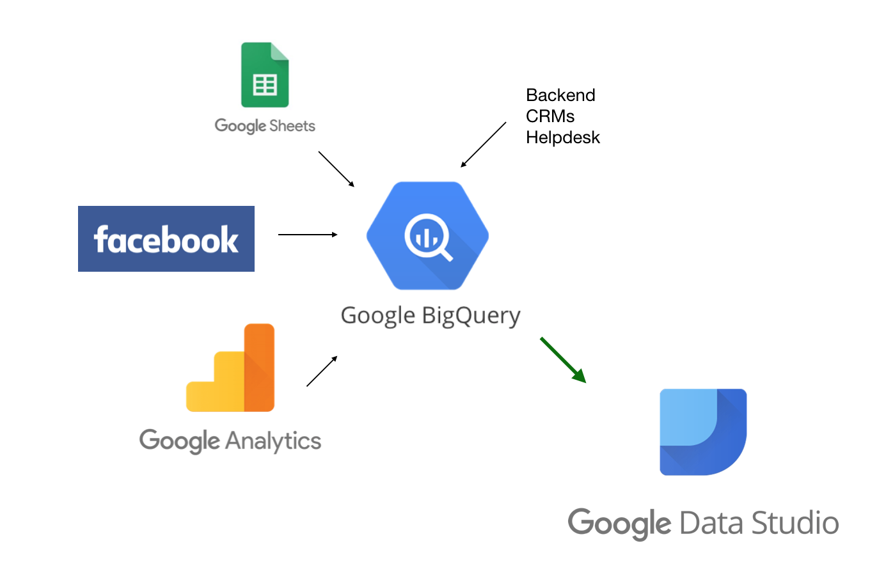
BigQuery is not a replacement for traditional RDBMS!
It is primarily designed for handling large volumes of structured and semi-structured data for analytical and reporting purposes.

Slide 4

Why is BigQuery 'not' Transactional?
BigQuery lacks key constraints.
Data is loaded rather than updated or deleted.
Lacks ACID (Atomicity, Consistency, Isolation and Durability) properties for transactions.

Slide 5

Key Features Overview
Fully Managed: No infrastructure management required
Scalability: Easily handle large datasets
Cost-Effective: Pay-as-you-go pricing
SQL Compatibility: Supports standard SQL queries
Real-time Data Analysis: Process data in real-time

Slide 6

Use Cases
Data Warehousing: Store and analyze structured data
Analytics: Complex data analysis and insights
Machine Learning: Integrates with ML for predictive analysis
Business Intelligence: Create interactive dashboards

Slide 7
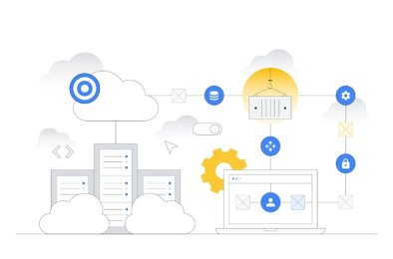
Benefits
Improved Performance: High-speed querying
Cost Savings: Eliminates on-premises hardware
Scalability: Handles growing data needs
Security: Data encryption and access controls
Fully Managed: Google handles maintenance

Slide 8
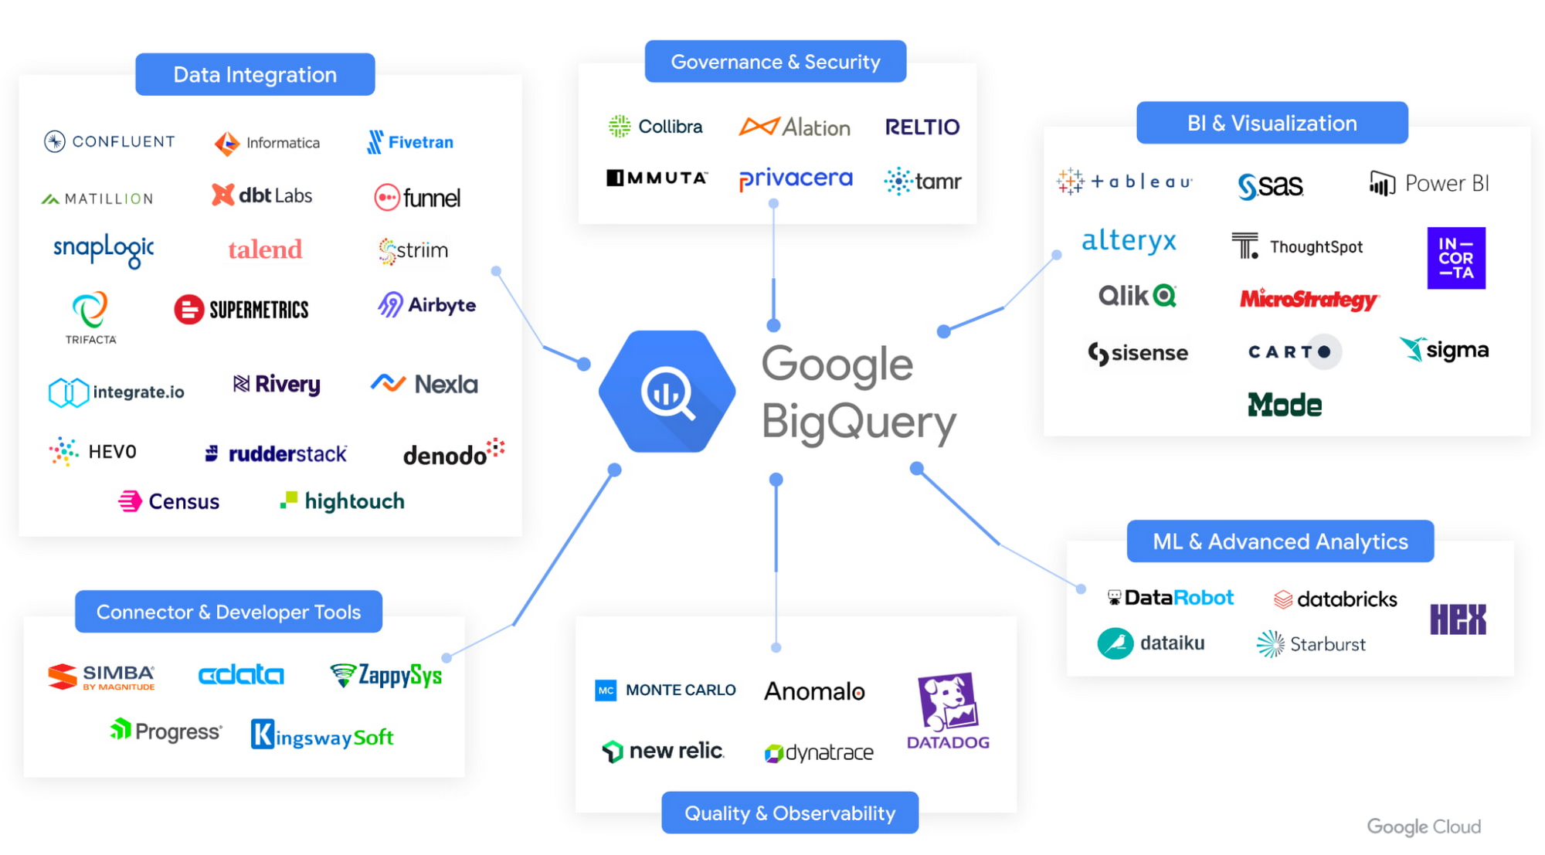
Integration
Seamless integration with other Google Cloud services
Easily move data in and out of BigQuery
Data connectors available for popular tools

Slide 9

Data Structures supported by BigQuery
Row Based Table Formats
Column Based Table Formats (ORC)
Key Value Pair Data (JSON)

Slide 10
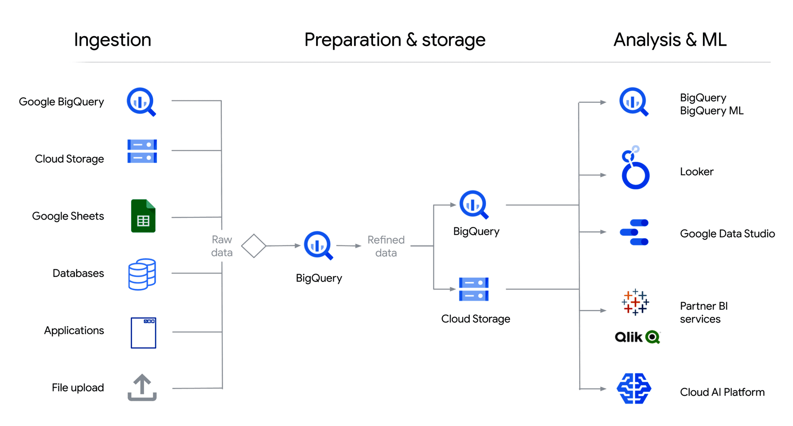
BigQuery Flowchart

Slide 11
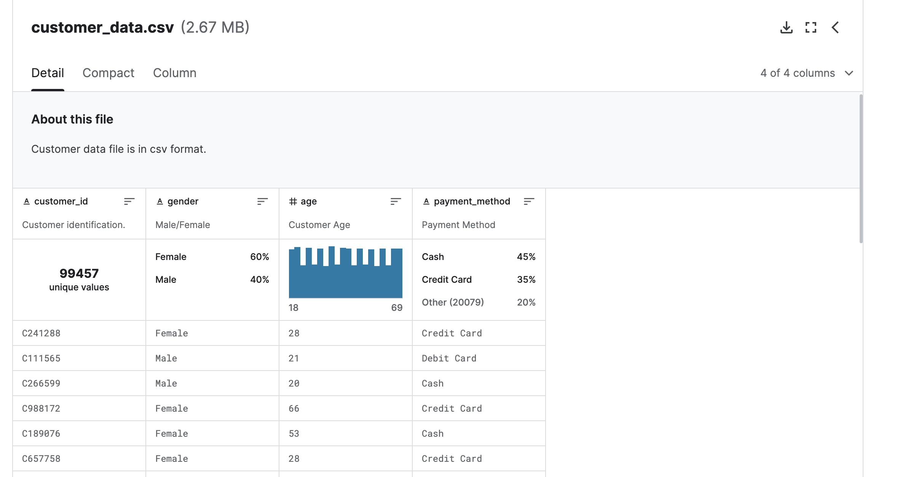
DataSet

Slide 12
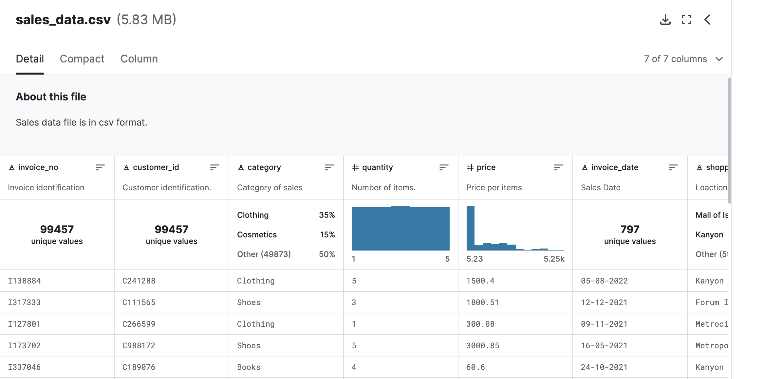
DataSet

Slide 13
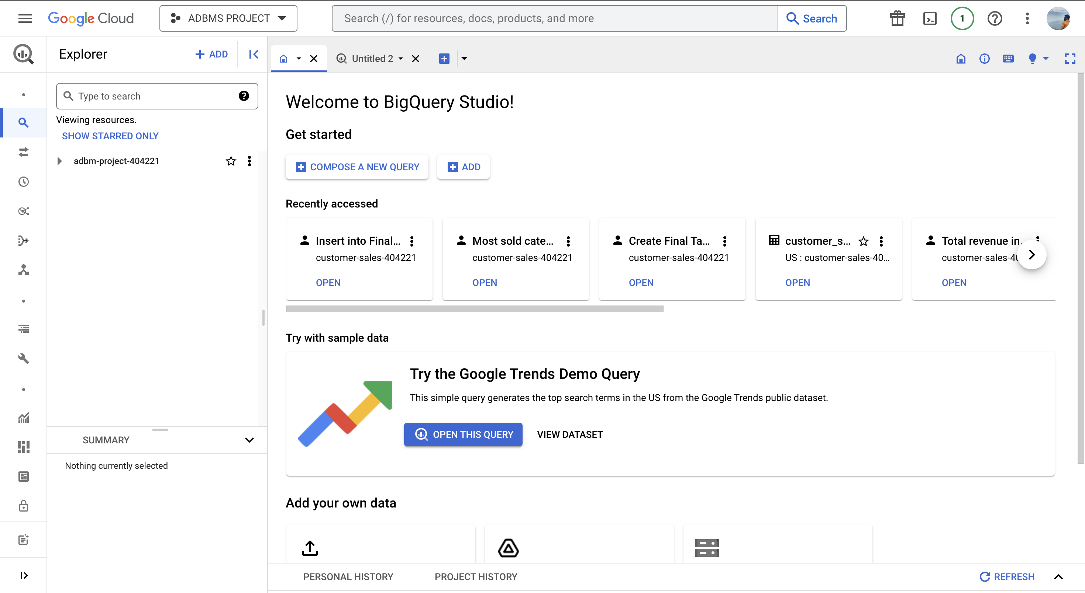
BigQuery Interface

Slide 14
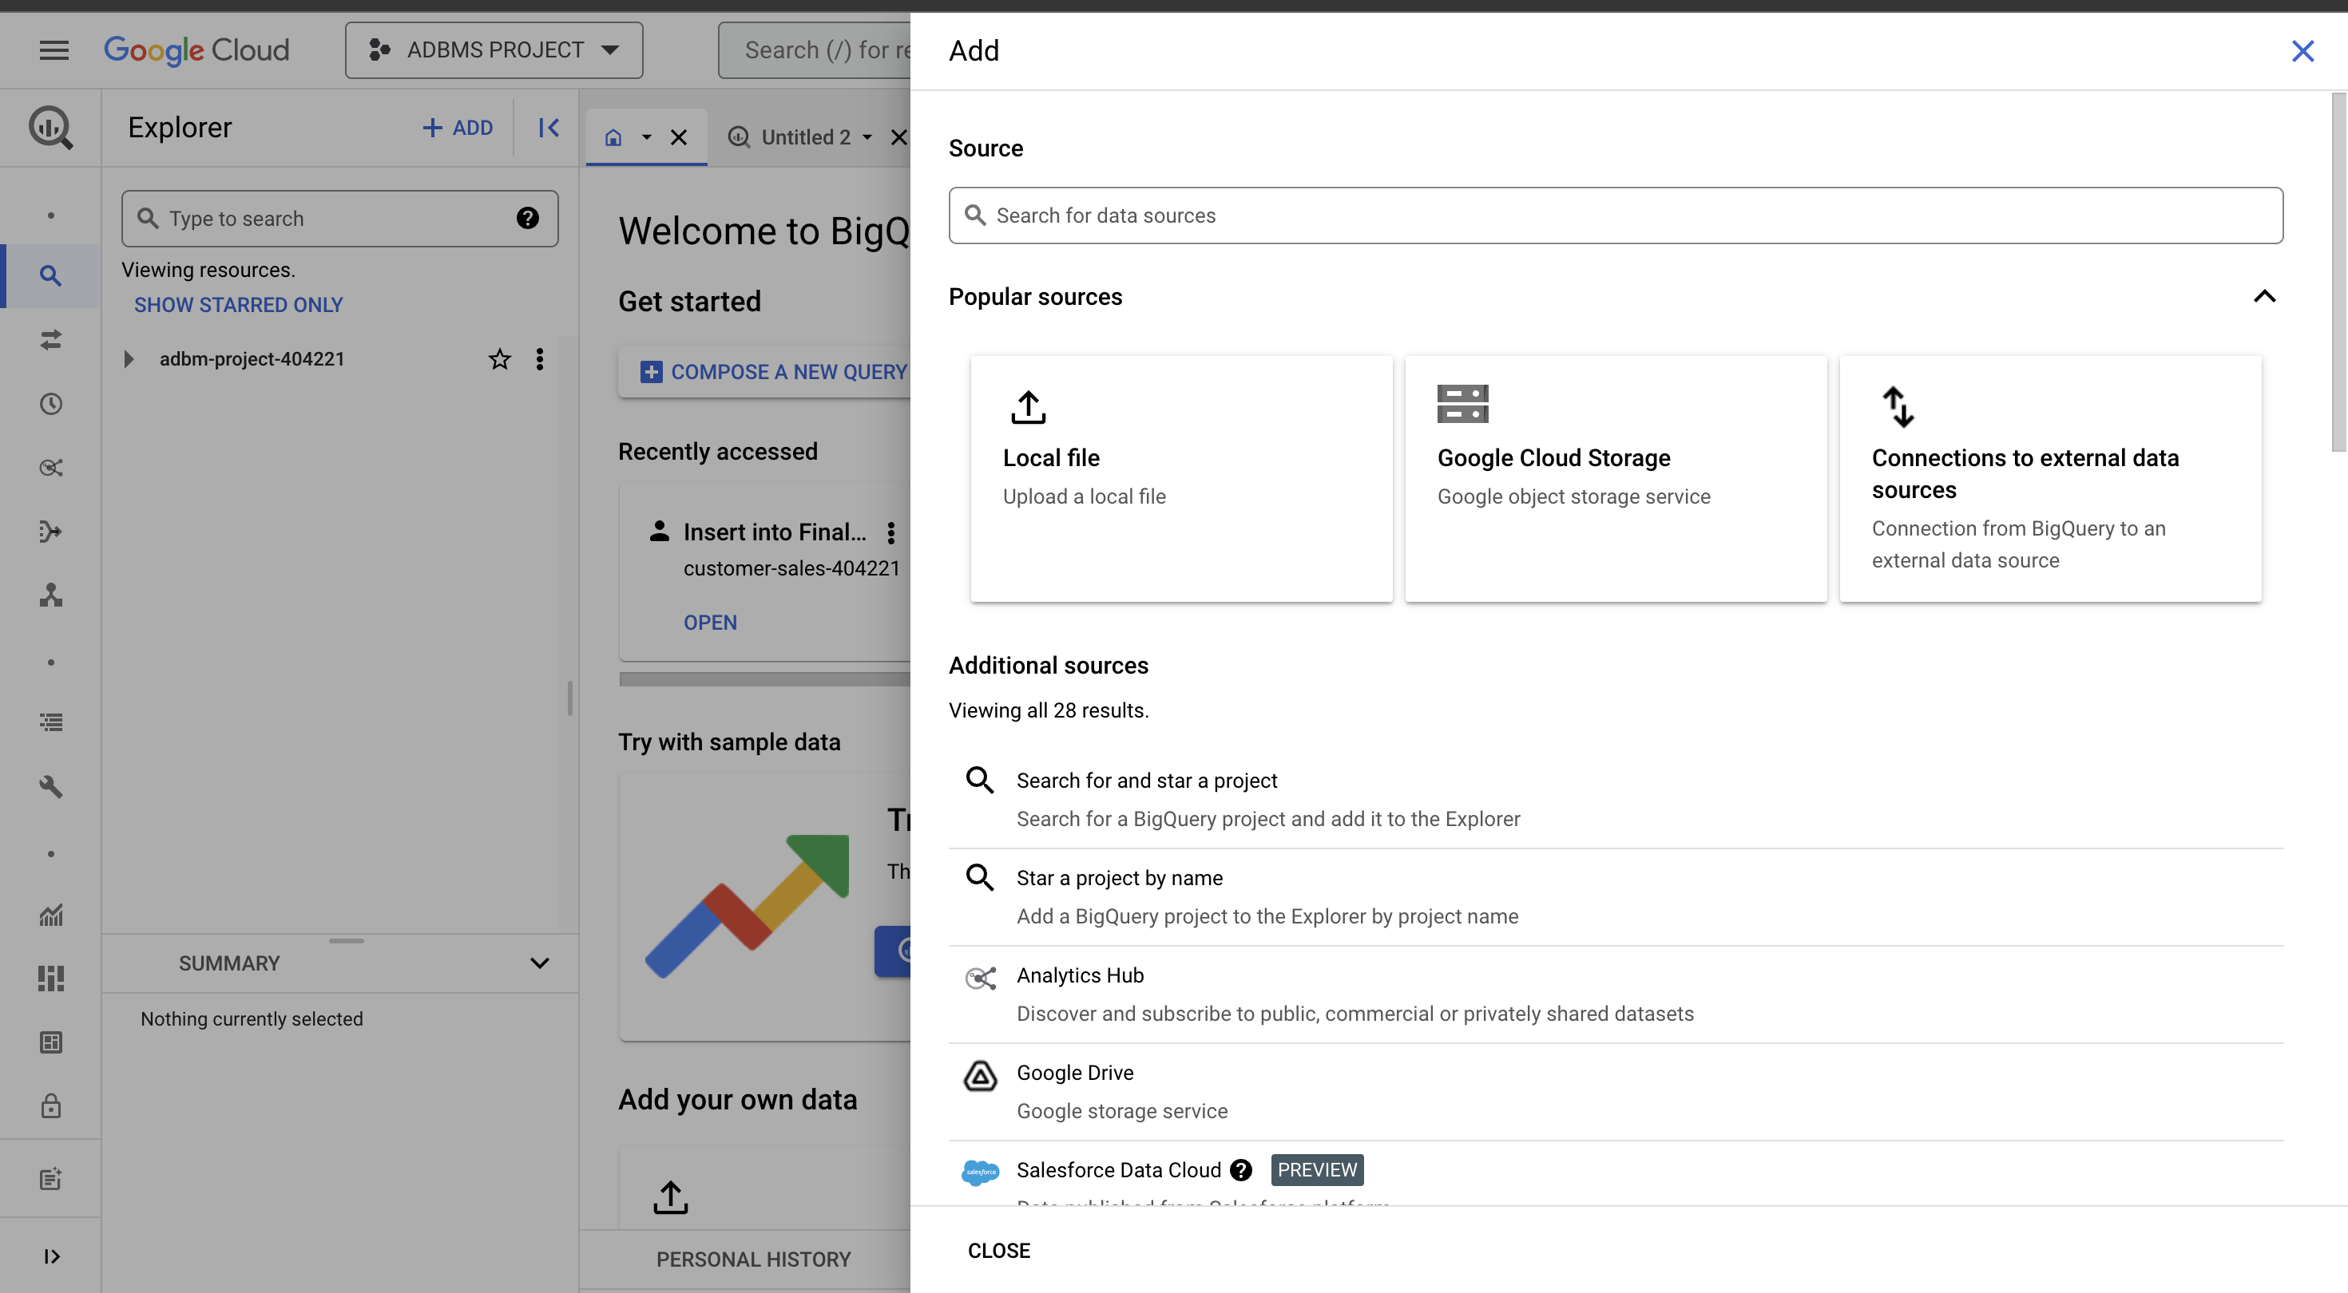
BigQuery ETL

Slide 15
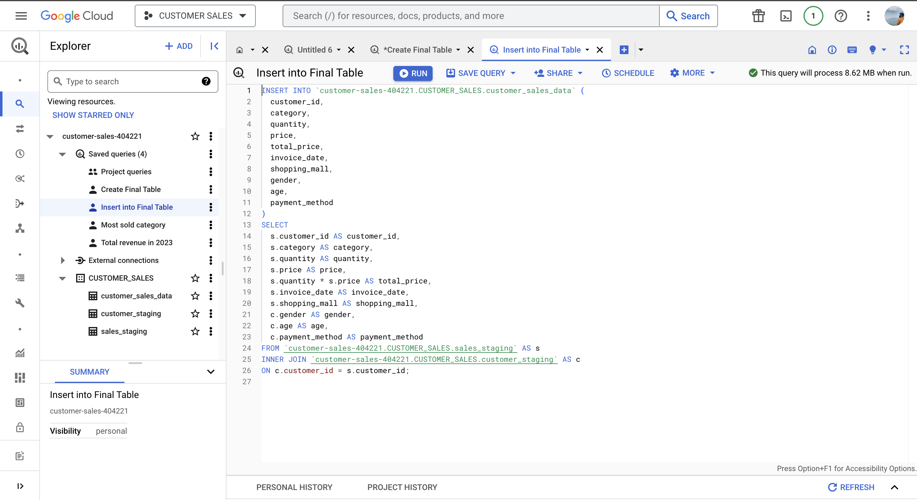
BigQuery ETL

Slide 16
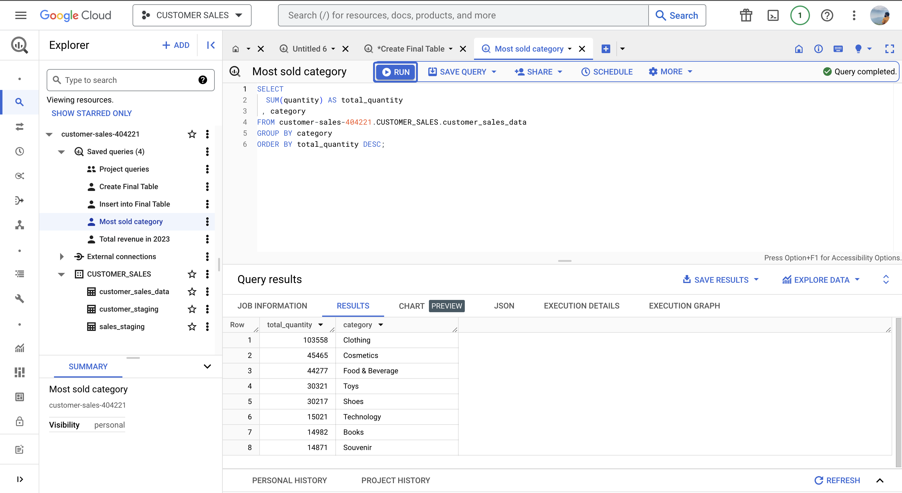
Querying

Slide 17
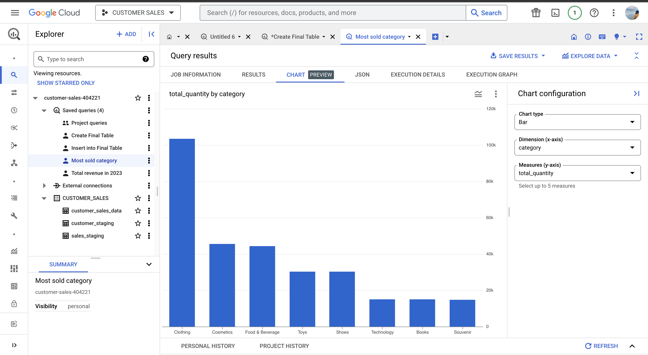
Analytics

Slide 18
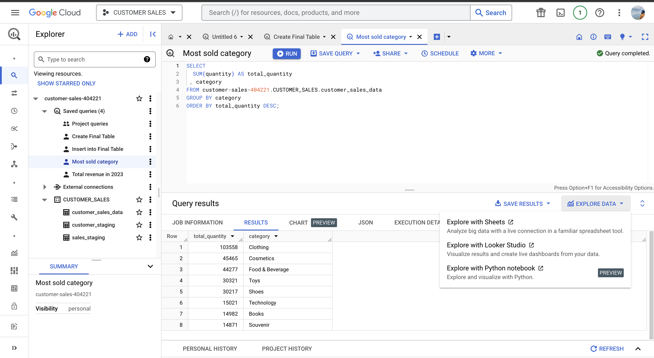
Exporting Results

Slide 19
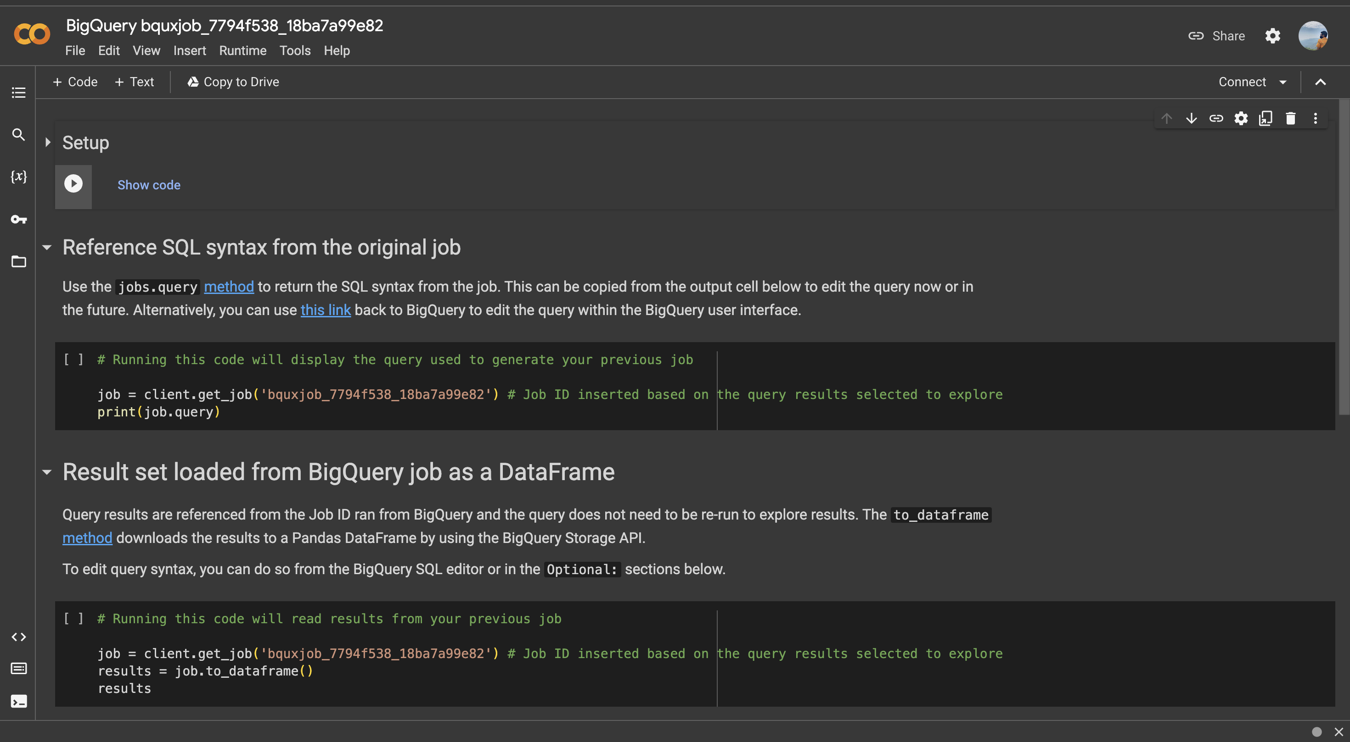
Google Colab Integration

Slide 20
MS Teams Video Link
Call with Noor and 2 others-20231107_213217-Meeting Recording.mp4
https://usfedu-my.sharepoint.com/:v:/g/personal/prajayreddy_usf_edu/EUblqNkB7sJElgmeAix7WVQBQ85tDoxRRZ_WEuEPPnvhqw?e=2b36j6

